Slide 1
WRITING AN ADVERTISEMENT

Slide 2
INTRODUCTION
Promotion of a product, brand
Service to a viewership done in order to
Kindle interest to promote sales
Involve a person in a particular commercial service

Slide 3
Importance of ads
Guaranteed method to reach an audience
Immediate impact on sales
Hence, improved trade or boosted brand recognition

Slide 4
Ways to advertise
Television
print (newspapers, magazines, journals etc),
radio, press, internet
direct selling
hoardings, mailers, contests, sponsorships, posters, clothes, events, colours, sounds, visuals and
even people (endorsements)

Slide 5

Lenovo used this concept to advertise their new face recognition feature on smartphones and computers. The concept of the ad is a man who inserts his head where he is supposed to enter the password. It is a simple logic with details of what to expect from Lenovo.

Slide 6
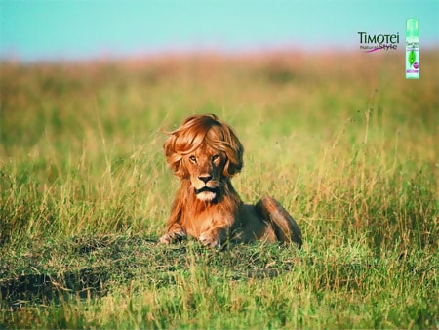
Hair Styling – Creative Advertising Ideas Timotei used this advertising concept to advertise their hair products. In the image, a Lion can be seen with curly and well-styled hair, meaning the product will work for any hair type and strength.

Slide 7
Guidelines to follow in writing an ad
Decide the medium of publishing an ad
Relate it to the target audience
Attention grabbing headline- exciting, emotional, compelling etc
Supporting lines must go with the headline
Should be framed so as to kindle interest and create desire
Add details- how to get the product(website, phone etc)

Slide 8
You may use such shapes to fill in your ads

Slide 9
